Slide 1
Misstakes We Have Made
Lessons from over 20 years combined .NET experience

Slide 2
30 minute intro on us
Mistake #1 : Long introductions that cut into beer time
Rhys : Writes the C#
Colin : Also writes the C#

Slide 3
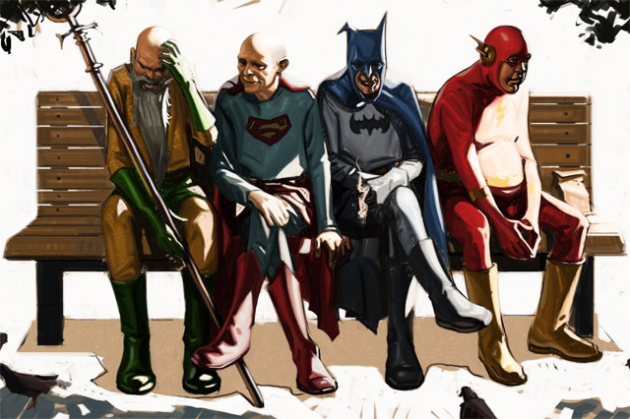
We screwed up
Notes:
We screwed up - Please learn from us and don't make these mistakes
We have been building .Net apps/solutions for many years, our (Colin and Rhys) learning's over the years have been somewhat parallel and we generally have come to similar conclusions about how not to build software.
This talk assumes you have been building code in the last 20 years and don't have a lot of GOTOs in your code, you use source control etc etc This is not really covering the bad practices of yesteryear but the practices that we think at the time are actually a good thing; when we did this we honestly thought were were kicking ass!

Slide 4
We screwed up
Learn from our fail
Assumptions about the audience
We actually did this and we thought we were doing the right thing
Notes:
We screwed up - Please learn from us and don't make these mistakes
We have been building .Net apps/solutions for many years, our (Colin and Rhys) learning's over the years have been somewhat parallel and we generally have come to similar conclusions about how not to build software.
This talk assumes you have been building code in the last 20 years and don't have a lot of GOTOs in your code, you use source control etc etc This is not really covering the bad practices of yesteryear but the practices that we think at the time are actually a good thing; when we did this we honestly thought were were kicking ass!

Slide 5

The Problems
Notes:
Your boss has a cheque book that is too big
you dont work for a start up so money really isnt that tight

Slide 6
The Problems
You are solving the wrong problem
Notes:
the problem is not "we dont have enough code" or "how clever is Developer X?"
It's also not "our boss has too much money, let's spend it"

Slide 7
Enterprise Nava Beans
SHOW ME THE CODEZ
Notes:
Why are there multiple projects? Assembly should/can be considered a unit of deployment
Stupid namespaces
DAL:
Orm is not justified
Session factory being static mean testing just went out the window
Hard code ConnString (Demo)
Generic repository
It add no value because it just wraps around the ORM… which is already an abstract
Query-ablity is either inefficient or leaky – what happens in Linq queries? What about closures? (“You had me at ToList()” – Garrry Stewart)
UOW is now blurred – is it the scope of the HTTP request or when the method returns? We now could have an inconsistent state and at the very least confused devs
Zombies?!?!? Where is the session? Should persistent object be going out of the application boundaries?
Mention Reattaching zombie persistent objects – its just mayhem
Service layer
Why god, why?
Add value or get deleted – justify your existence
Needlessly a singleton
Stateless objects are very cheap
Understand lifecycles especially if you use an IoC container
Maybe we should log? But why – its just noise if your boundaries are dealing with this appropriately
UI
Routes are a mess
Sending the persistent object over the wire. Just go to rails…
Colin cant even screw this up enough – status codes actually mean something – use the correct ones
Scaffolding is great – but clean as you go. If you are not using delete it – if is just making life harder for the next guy
Use the correct tool for the job – web api would be better here (Given this is MVC4)

Slide 8
Hiding intent
Service locator
Property injection
Lasagne architectures – over abstraction

Slide 9
Testability
Assuming a class is a functional unit
Statics
Inaccessible code
Not isolating the untestable
Avoiding integration test at all cost

Slide 10
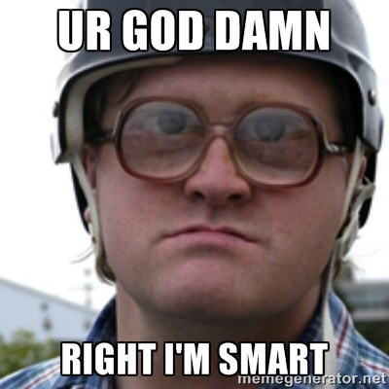
Being too smart
Notes:
Code generation…. Its not the same as scaffolding or runtime code gen
Excessive complexity
Debugging is harder than developing
things Parallel the all!
Premature optimization
Performance tuning without measure or defining the acceptable performance
Unrealistic performance testing

Slide 11
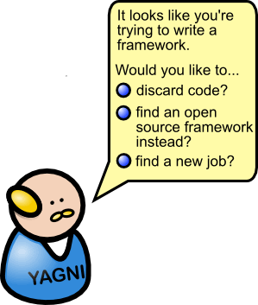
Being too smart

Slide 12
A simpler way
Notes:
Nancy is lightweight and is out of the way (Autofac is used for DB connections)
HTTP is acknowledged
Requests are specific and as such so are the parameter object used
Projections are specific also meaning leaner responses and improved security (no leaks)
REST side bar : Representational state transfer – NOT Resource state transfer
Using non M$ tech were it makes sense.
This solution even included validation!

Slide 13
…hold on!
Test have to be integration test (Nancy supports this well)
However they are more explicit!
SRP?
The functional responsibility is correct, but there are technical concerns mixed. The size and complexity of this solution means this is ok*.
If warranted the modules can be split or use dependencies

Slide 14
Ego
Think of the children!!!
Collective code ownership
Feedback is not a personal attack – its just code
“Strong opinions, weakly held”
One day you will look back and know that your were wrong
Nothing is perfect so acknowledge the trade offs and don’t be afraid to change them
Notes:
We all have ego's that come into play, but at the end of the day there is a bottom line to think of. Getting something out the door is great but we still have to be able to maintain the code base. That includes
Fixing bugs:
knowing there is a bug (are you users your monitoring system?)
Identity the bug,
where it is being caused,
fixing the bug
preventing it from happening again
make sure the fix doesnt break something else
getting it back into production
Extending the application
new functionality
scale
tech upgrades (libs/package/security patches)

Slide 15
Its a balancing act
GSD vs maintainable software
Buy vs build
Abstract vs Concrete
Terseness vs clarity
Pragmatic vs Pedantic
At the end of the day if it was your money what would you do... remember you (as a resource) are expensive!
Notes:
At the end of the day if it was your money what would you do... remember you (as a resource) are expensive!

Slide 16
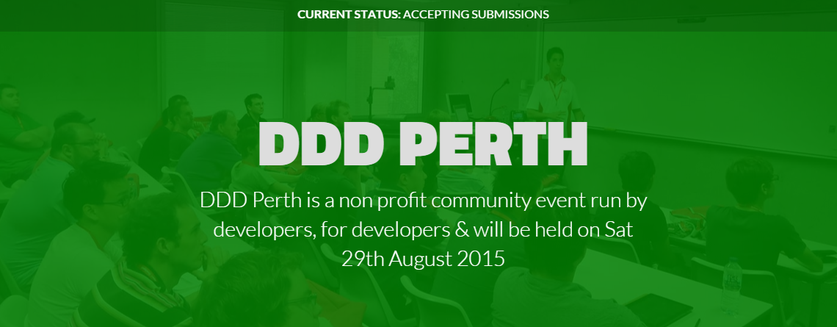

Slide 17
“F__k WCF” - CDS

